Slide 1
Forecast-error experiments
MSc THESIS · EXPERIMENTS
How much welfare is lost when batteries bid with a price forecast?
Carlos Canoyra Calero · Supervisor: Jalal Kazempour · Co-supervisor: Lukas Alfred Stippel · November 2026

Slide 2
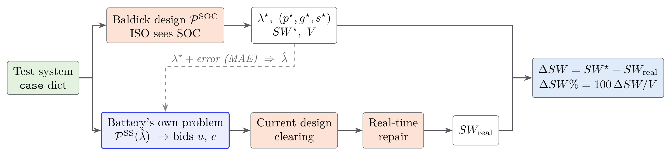

With perfect prices nothing is lost. What does a forecast error cost?
1 · SET-UP

Slide 3
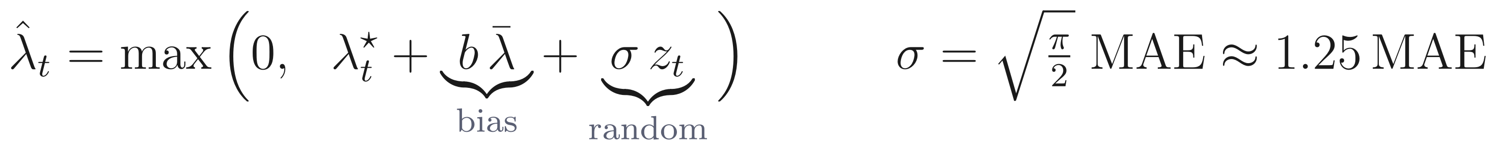
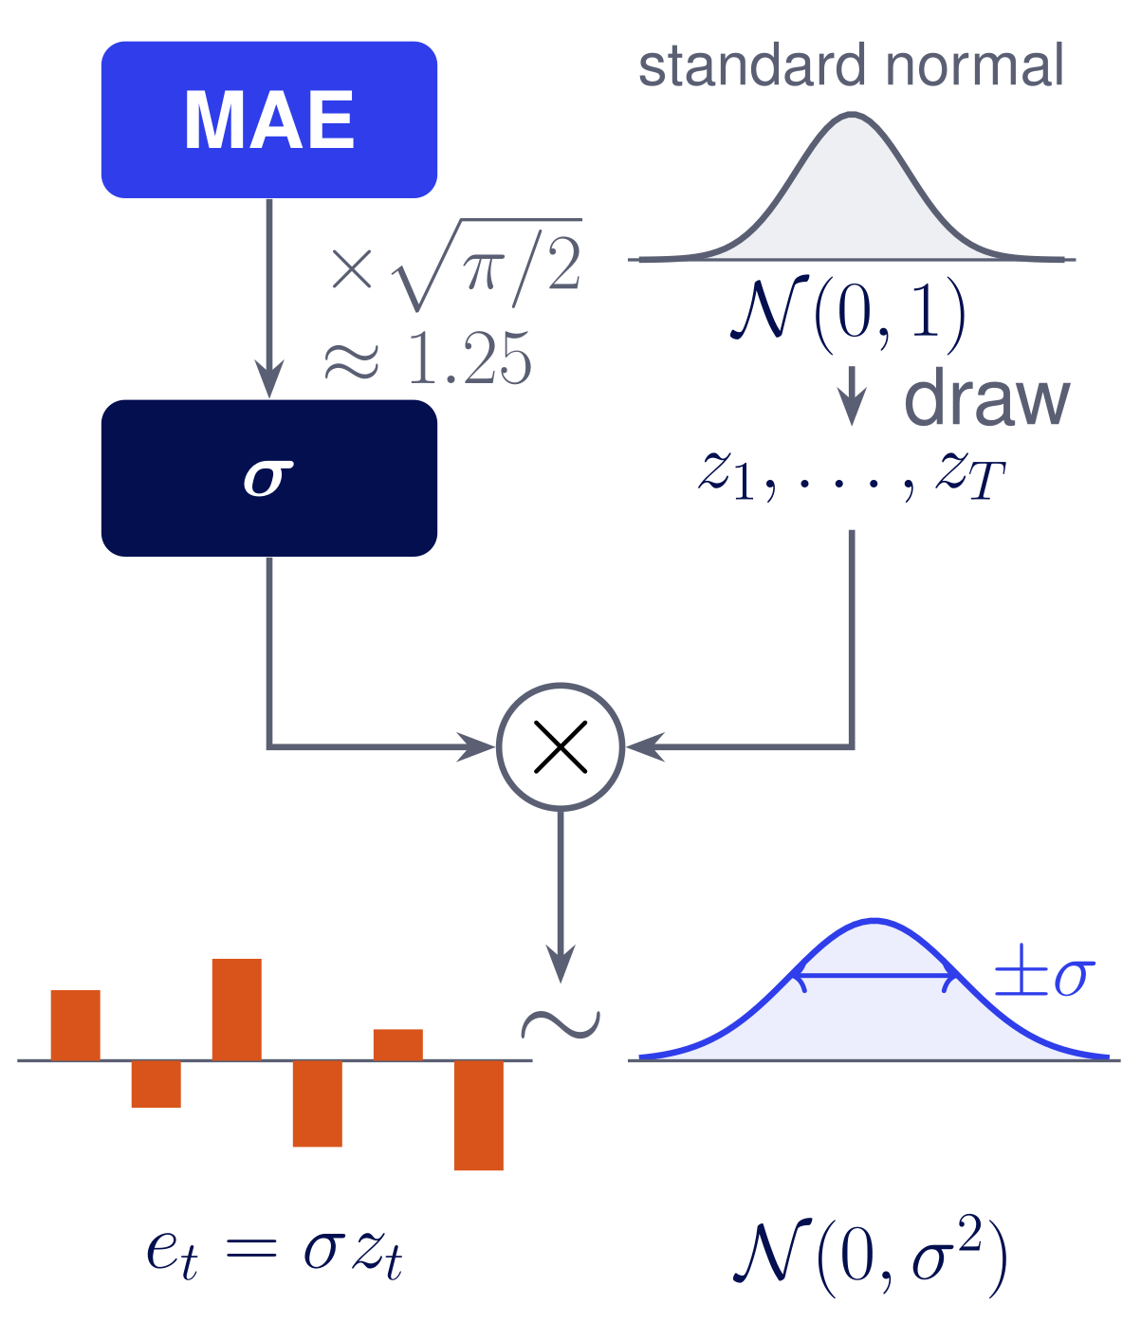
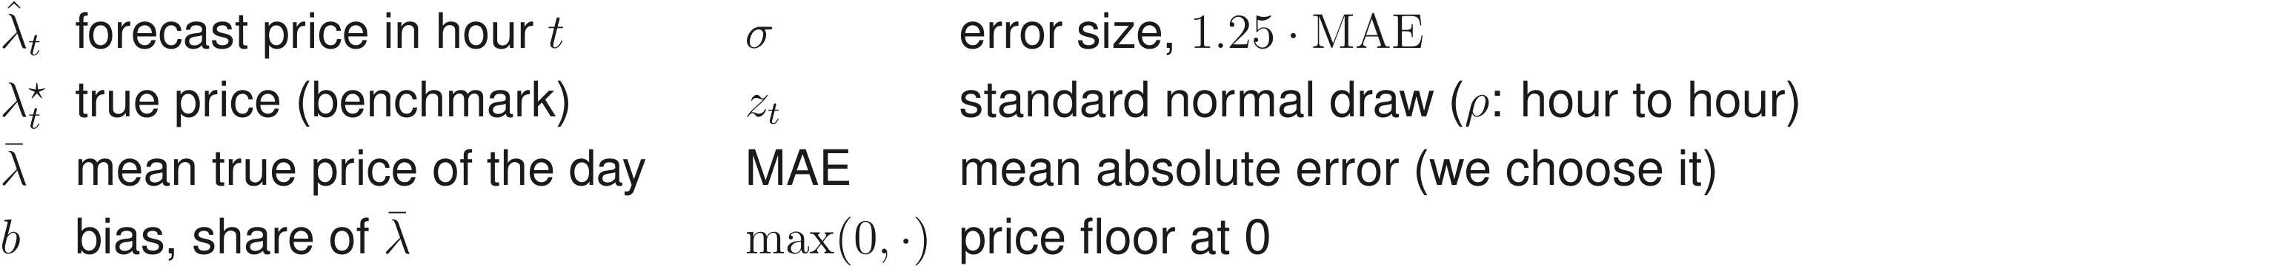
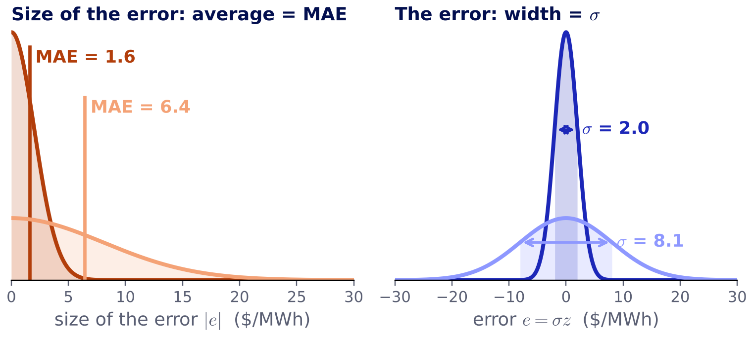
From the MAE to the random errors
2 · FORECAST ERRORS

Slide 4
Which MAE values? The grid brackets real forecasts
2 · FORECAST ERRORS
state-of-the-art forecasts
naive forecasts / no skill
0%
2.5%
5%
10%
20%
40%
Lago et al. (2021): open benchmark of day-ahead price forecasts in five markets.

Slide 5




Three ways the battery can bid
3 · BIDS
Exact prices
Forecast prices
No forecast

Slide 6
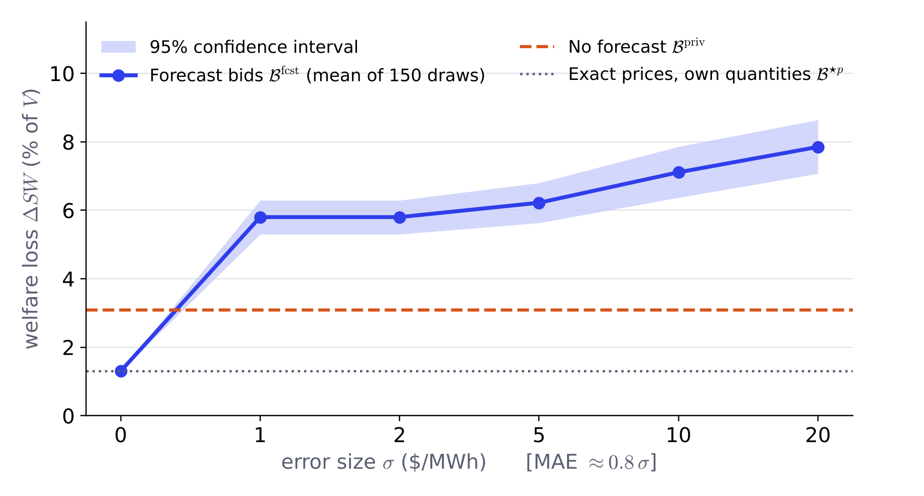
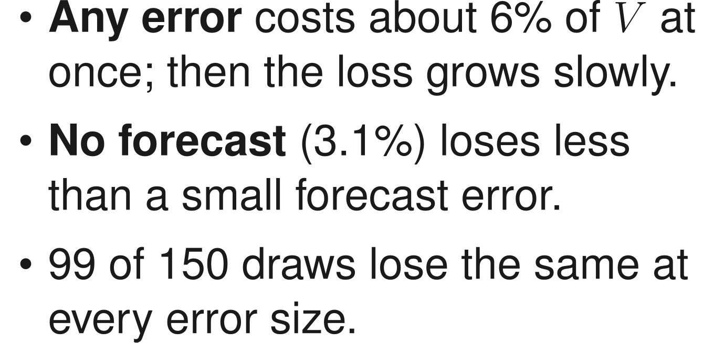
First results on Baldick's base case
4 · FIRST RESULTS

Slide 7
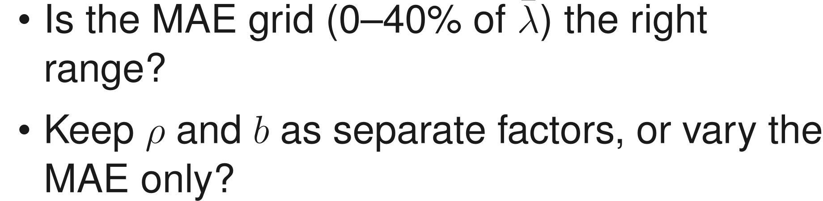
Next steps, and two questions
5 · NEXT STEPS
1
Switch the input to the MAE
For discussion
2
Two batteries
3
Larger systems

